Slide 1

Chapter 4
Network Layer
Computer Networking: A Top Down Approach
6th edition
Jim Kurose, Keith Ross
Addison-Wesley
March 2012
Network Layer
4-<number>

Slide 2
Connection setup
One important function in some network architectures:
  ATM, frame relay, X.25
before datagrams flow, two end hosts and intervening routers establish virtual connection
  routers get involved
network vs transport layer connection service:
  network: between two hosts (may also involve intervening routers in case of VCs)
  transport: between two processes
Network Layer
4-<number>
Notes:
Recall that the network layer of the Internet has three main components: the IP protocol,
discussed in the previous section; the Internet routing protocols (including
RIP, OSPF, and BGP), which are covered in Section 4.6; and ICMP, which is the
subject of this section.
ICMP, specified in [RFC 792], is used by hosts and routers to communicate network-
layer information to each other. The most typical use of ICMP is for error
reporting. For example, when running a Telnet, FTP, or HTTP session, you may
have encountered an error message such as “Destination network unreachable.” This
message had its origins in ICMP. At some point, an IP router was unable to find a
path to the host specified in your Telnet, FTP, or HTTP application. That router created
and sent a type-3 ICMP message to your host indicating the error.

Slide 3
Connection, connection-less service
datagram network provides network-layer connectionless service
virtual-circuit network provides network-layer connection service
analogous to TCP/UDP connecton-oriented / connectionless transport-layer services, but:
  service: host-to-host
  no choice: network provides one or the other
  implementation: in network core
Network Layer
4-<number>

Slide 4
Virtual circuits
“source-to-dest path behaves much like telephone circuit”
  performance-wise
  network actions along source-to-dest path
call setup, teardown for each call before data can flow
each packet carries VC identifier (not destination host address)
every router on source-dest path maintains “state” for each passing connection
link, router resources (bandwidth, buffers) may be allocated to VC (dedicated resources = predictable service)
Network Layer
4-<number>

Slide 5
VC implementation
a VC consists of:
  path from source to destination
  VC numbers, one number for each link along path
  entries in forwarding tables in routers along path
packet belonging to VC carries VC number (rather than dest address)
VC number can be changed on each link.
  new VC number comes from forwarding table
Network Layer
4-<number>

Slide 6

VC forwarding table
12
22
32
1
3
2
VC number
forwarding table in
northwest router:
interface
number
Incoming interface Incoming VC # Outgoing interface Outgoing VC #
1 12 3 22
2 63 1 18
3 7 2 17
1 97 3 87
… … … …
VC routers maintain connection state information!
Network Layer
4-<number>

Slide 7
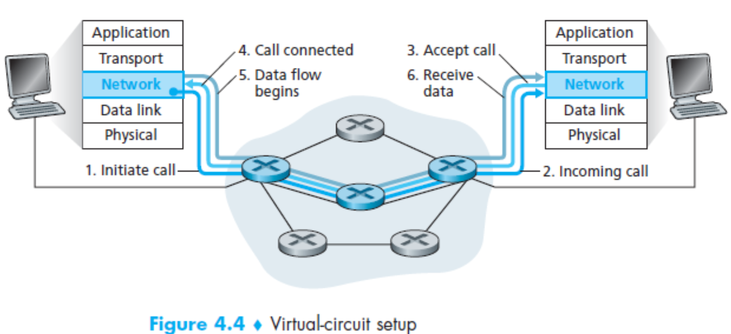
Virtual circuits: signaling protocols
used to setup, maintain teardown VC
used in ATM, frame-relay, X.25
not used in today’s Internet
Network Layer
4-<number>
Notes:
The messages that the end systems send into the network to initiate or terminate a
VC, and the messages passed between the routers to set up the VC (that is, to modify
connection state in router tables) are known as signaling messages, and the protocols used to exchange these messages are often referred to as signaling protocols

Slide 8

Datagram networks
no call setup at network layer
routers: no state about end-to-end connections
  no network-level concept of “connection”
packets forwarded using destination host address
application
transport
network
data link
physical
application
transport
network
data link
physical
1. send datagrams
2. receive datagrams
Network Layer
4-<number>

Slide 9
Datagram forwarding table
4 billion IP addresses, so rather than list individual destination address
list range of addresses
(aggregate table entries)
routing algorithm
local forwarding table
dest address
output link
address-range 1
address-range 2
address-range 3
address-range 4
3
2
2
1
IP destination address in
arriving packet’s header
1
3
2
Network Layer
4-<number>

Slide 10
Datagram forwarding table
Destination Address Range
11001000 00010111 00010000 00000000
through
11001000 00010111 00010111 11111111
11001000 00010111 00011000 00000000
through
11001000 00010111 00011000 11111111
11001000 00010111 00011001 00000000
through
11001000 00010111 00011111 11111111
otherwise
Link Interface
0
1
2
3
Q: but what happens if ranges don’t divide up so nicely?
Network Layer
4-<number>

Slide 11
Longest prefix matching
longest prefix matching
when looking for forwarding table entry for given destination address, use longest address prefix that matches destination address.
Destination Address Range
11001000 00010111 00010*** *********
11001000 00010111 00011000 *********
11001000 00010111 00011*** *********
otherwise
Link interface
0
1
2
3
examples:
DA: 11001000 00010111 00010110 10100001
which interface?
DA: 11001000 00010111 00011000 10101010
which interface?
Network Layer
4-<number>
Notes:
172.30.40.0 – 172.30.40.255 (256)
Network part , host part
Prefix , suffix

Slide 12
Datagram or VC network: why?
Internet (datagram)
data exchange among computers
  “elastic” service, no strict timing req.
many link types
  different characteristics
  uniform service difficult
“smart” end systems (computers)
  can adapt, perform control, error recovery
  simple inside network, complexity at “edge”
ATM (VC)
evolved from telephony
human conversation:
  strict timing, reliability requirements
  need for guaranteed service
“dumb” end systems
  telephones
  complexity inside network
Network Layer
4-<number>

Slide 13
The Internet network layer
host, router network layer functions:
transport layer: TCP, UDP
routing protocols
path selection
RIP, OSPF, BGP
IP protocol
addressing conventions
datagram format
packet handling conventions
network
layer
forwarding
table
ICMP protocol
error reporting
router “signaling”
link layer
physical layer
Network Layer
4-<number>
Notes:
RIP routing information
OSPF open shortest path first
BGP border gateway protocol
ICMP internet control messaging protocol

Slide 14
IP datagram format
IP protocol version
number
32 bits
total datagram
length (bytes)
header length
(bytes)
head.
len
type of
service
ver
length
for
fragmentation/
reassembly
“type” of data
flgs
fragment
offset
16-bit identifier
max number
remaining hops
(decremented at
each router)
time to
live
upper
layer
header
checksum
32 bit source IP address
upper layer protocol
to deliver payload to
32 bit destination IP address
options (if any)
e.g. timestamp,
record route
taken, specify
list of routers
to visit.
data
(variable length,
typically a TCP
or UDP segment)
how much overhead?
20 bytes of TCP
20 bytes of IP
= 40 bytes + app layer overhead
Network Layer
4-<number>
Notes:
Chapter 4 pg# 333

Slide 15
IP fragmentation, reassembly
network links have MTU (max.transfer size) - largest possible link-level frame
  different link types, different MTUs
large IP datagram divided (“fragmented”) within net
  one datagram becomes several datagrams
  “reassembled” only at final destination
  IP header bits used to identify, order related fragments
…
fragmentation:
in: one large datagram
out: 3 smaller datagrams
reassembly
…
Network Layer
4-<number>

Slide 16
IP fragmentation, reassembly
length
=4000
ID
=x
fragflag
=0
offset
=0
example:
4000 byte datagram
MTU = 1500 bytes
one large datagram becomes
several smaller datagrams
1480 bytes in
data field
length
=1500
ID
=x
fragflag
=1
offset
=0
offset =
1480/8
length
=1500
ID
=x
fragflag
=1
offset
=185
length
=1040
ID
=x
fragflag
=0
offset
=370
Network Layer
4-<number>

Slide 17
IPv6: motivation
initial motivation: 32-bit address space soon to be completely allocated.
additional motivation:
  header format helps speed processing/forwarding
  header changes to facilitate QoS
IPv6 datagram format:
  fixed-length 40 byte header
  no fragmentation allowed
Network Layer
4-<number>

Slide 18
IPv6 datagram format
priority: identify priority among datagrams in flow
flow Label: identify datagrams in same “flow.”
(concept of“flow” not well defined).
next header: identify upper layer protocol for data
ver
pri
flow label
payload len
next hdr
hop limit
source address
(128 bits)
destination address
(128 bits)
data
32 bits
Network Layer
4-<number>

Slide 19
Other changes from IPv4
checksum: removed entirely to reduce processing time at each hop
options: allowed, but outside of header, indicated by “Next Header” field
ICMPv6: new version of ICMP
  additional message types, e.g. “Packet Too Big”
  multicast group management functions
Network Layer
4-<number>

Slide 20
Interplay between routing, forwarding
routing algorithm determines
end-end-path through network
routing algorithm
forwarding table determines
local forwarding at this router
local forwarding table
dest address
output link
address-range 1
address-range 2
address-range 3
address-range 4
3
2
2
1
IP destination address in
arriving packet’s header
1
3
2
Network Layer
4-<number>

Slide 21
Types of Routing
Static Routing
Manually routing information needs to be added in each router
Dynamic Routing
Routers dynamically exchange routing information and periodically updates the routing information
  RIP, BGP,OSPF
Network Layer
4-<number>

